Slide 1
ACME Systems Inc.
Project ETHOS
ISM 6106
Miguel Acuna
Philip Dacosta
Gustavo Pinedo
Anthony Ramos
Notes:
Miguel

Slide 2
Who are we
Team Members | Role | Responsibilities
Anthony Ramos | Project Lead | Lead Code Dev, Manage Eclipse Manage Github
Gustavo Pinedo | QA Tester | 1. Check the diagrams for possible errors that will cause bugs or errors 2. Run models to ensure all works as planned and give feedback if any problems 3. Assist QA of eclipse and documentation 4. Assist in presentation
Miguel Acuna | Director of IT infrastructure | Manage the Access Management Model Design Manage the Class Diagram Manage the State Diagram
Philip DaCosta | Application Developer Manager | Project Manager- Facilitation of project and document Management Assist Lead Code dev and QA Eclipse code Manage the Database Implementation Manage the Group Presentation
Notes:
Miguel

Slide 3

Who are we
Systems Inc.
ACME Systems Inc. is one of the largest logistics and transportation companies with over 25,000 employees across North America.
Beginning in 2015, ACME Systems Inc. started acquiring small and medium-sized logistics and transportations competitors at a rapid pace in order to acquire market share.
With time, ACME Systems Inc. has begun to integrate these systems into the organization.
Notes:
Miguel

Slide 4
Problems Found
Lack of a Access Control Management
Since ACME Systems Inc. is growing rapidly, a system is needed to integrate to various systems since a comprehensive upgrade to the newly acquired companies would be too costly.
Insufficient Control Over Volume
Over time, the company has been unable to completely and accurately perform User Access Controls due to the volume of issues related to the IT systems that do not communicate with Active Directory.
Excessive Hours to Manage
Employees are dedicating too many hours to perform access control management.
Unable to Restrict Access to employees
Company is unable to terminate employees access to the offices or premises in a timely manner.
Notes:
Miguel

Slide 5
Analysis and Recommendations
We need a middleware application system to integrate various legacy and compatible systems (e.g., Active Directory).
This will allow ACME Systems Inc.to centralize and effectively manage users’ access for all systems, which will give IT and Information Security the ability to manage access controls within a centralized application to alleviate process issues and streamline the access control process.
This centralized process should give assurance that users are assigned the right access, and terminated employees are removed from the system timely and completely.
Ultimately, the application will be built as a standalone application with a GUI. A simple streamlined application will allow for ease of use for the security team that will utilize the application within their day-to-day processes.
Notes:
Miguel

Slide 6
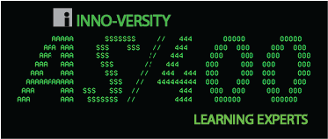


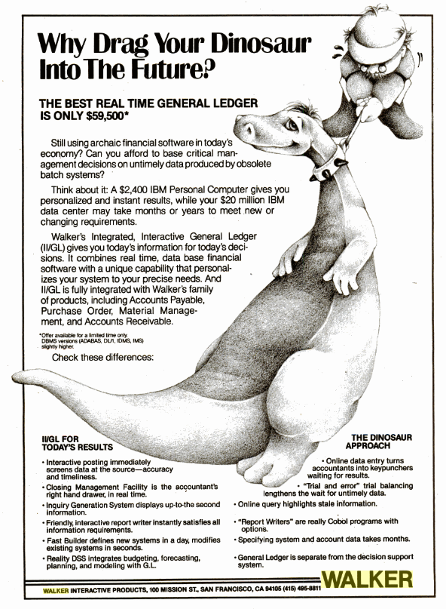
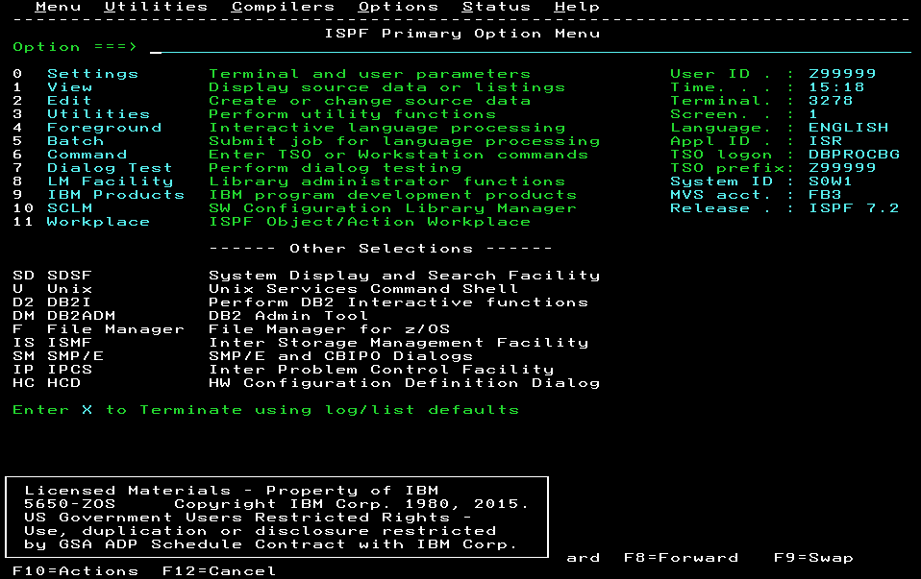
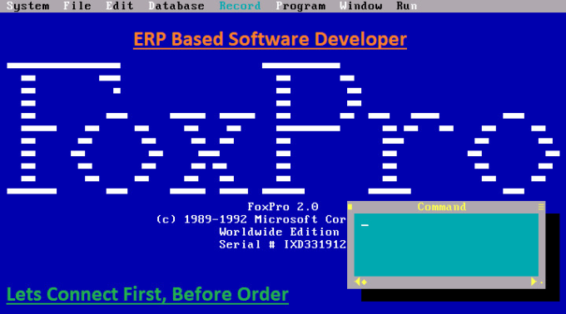
Why? No centralized User Access
Systems Inc.
Legacy Applications
Walker Financials AP/AR/GL
Physical Access Control Systems
Notes:
Anthony

Slide 7

ETHOS - we can centralize all access types
Systems Inc.
Legacy Applications
ETHOS
Walker Financials AP/AR/GL
Physical Access Control Systems
Notes:
Anthony

Slide 8

Ethos Purpose
Versatile - Designed as a middleware application to integrate various systems
Compatible legacy and modern (e.g., Active Directory).
Effective - Effectively manage users’ access for all systems
Capable - Ability to manage access controls within a centralized application
Alleviate process issues and streamline the access control process.
Assurance that users are assigned the right access, and terminated employees are removed from the system.
Secure - Built as a standalone application with a GUI.
Easy to use, built for Information Security team
Streamline day-to-day processes.
Notes:
Anthony

Slide 9

Ethos Specifications
System Connectors - API
Develop a system connector
Develop the ability to write protocols in order to interact with the systems
Database Interface
Connect the systems to create a centralized User Access Control matrix.
User Management Interface
Must be able to add users
Must be able to remove and terminate users
Use Active and End Dates
Must be able to suspend user access
Must have the ability to assign user access
Assign and remove physical access
Assign and remove physical ID cards for user access
Notes:
Anthony

Slide 10

Ethos Specifications Cont.
Access Group Management
Develop Groups
Must be able to add groups
Must be able to remove and add groups
Must be able to suspend groups
Must have the ability to assign users to a group
Reporting Capabilities
Develop Reports
The ability to report on system licenses
The ability to report on employee management events
The ability of successful and failure events
The ability to provide a log of user access history
Connect to Database
Connect to a database for backup and reporting
Notes:
Anthony

Slide 11
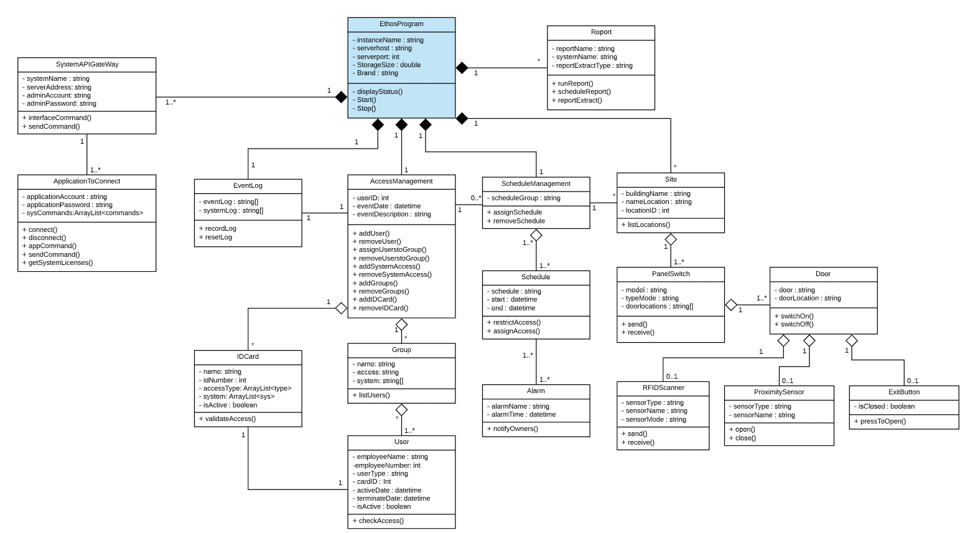
Class Diagram
Notes:
Philip

Slide 12
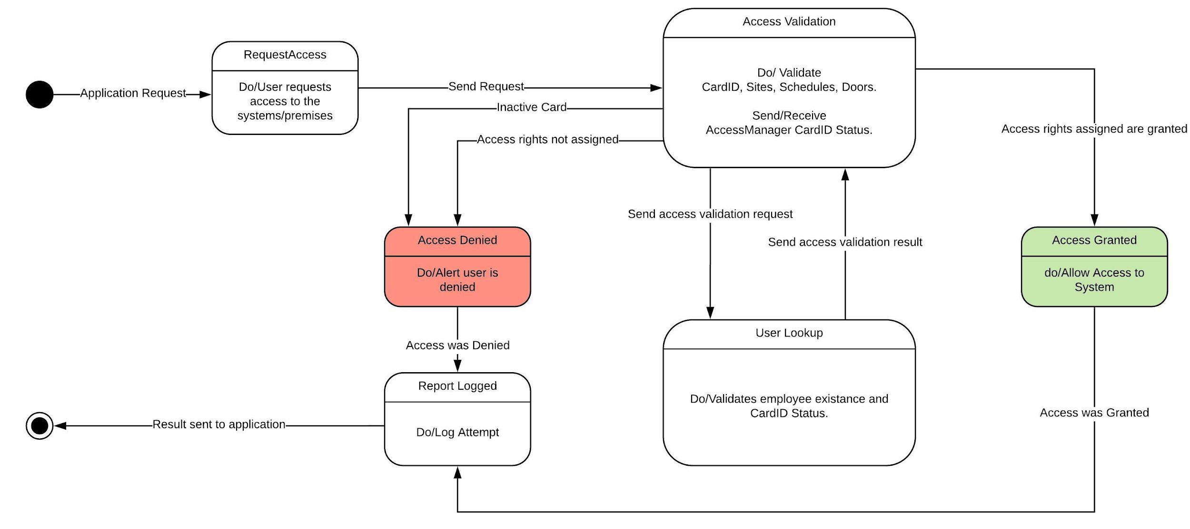
State Diagram : Access Management
Notes:
Philip

Slide 13

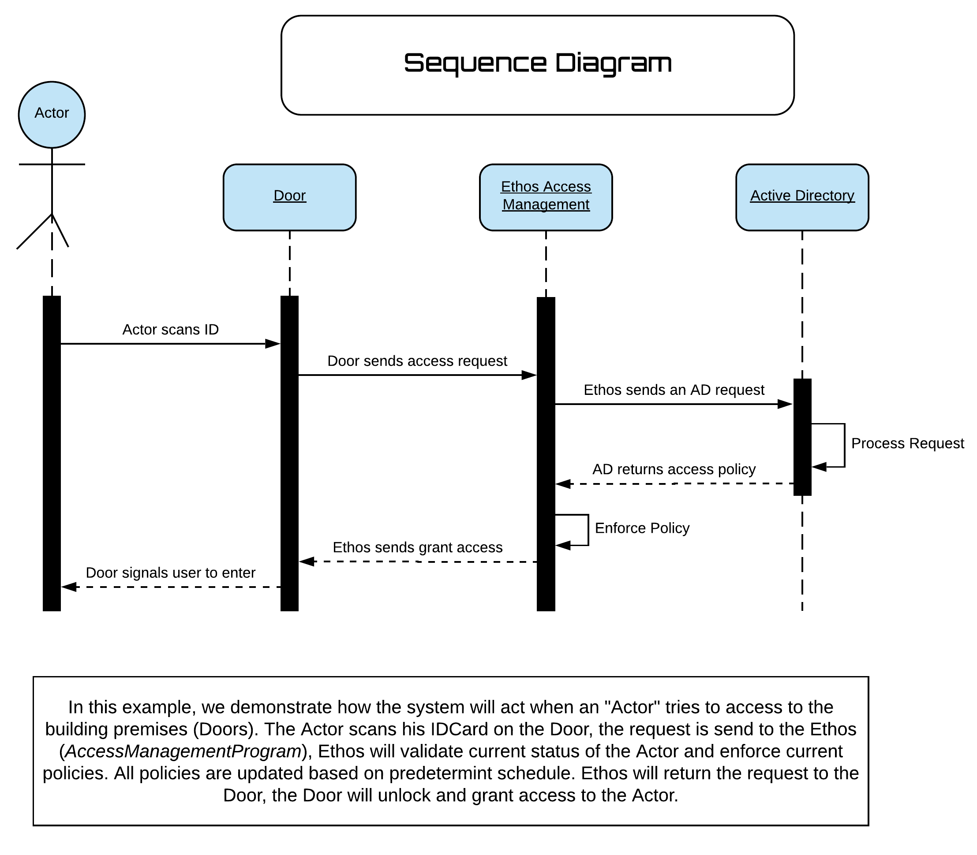
Sequence Diagram: Physical Access
Notes:
Philip

Slide 14
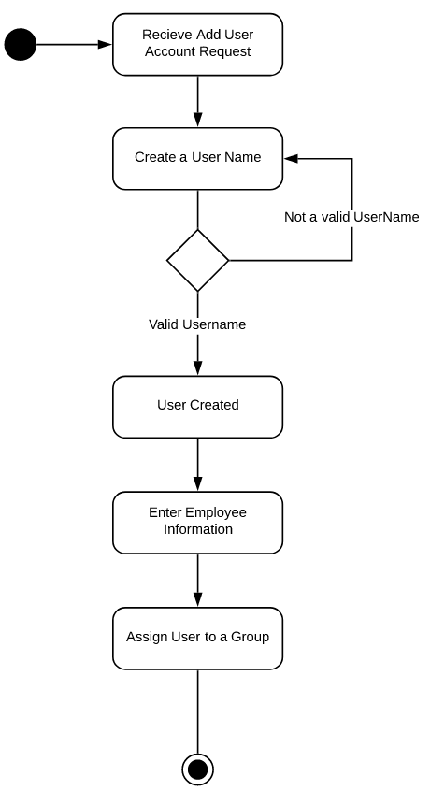
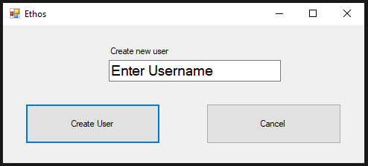
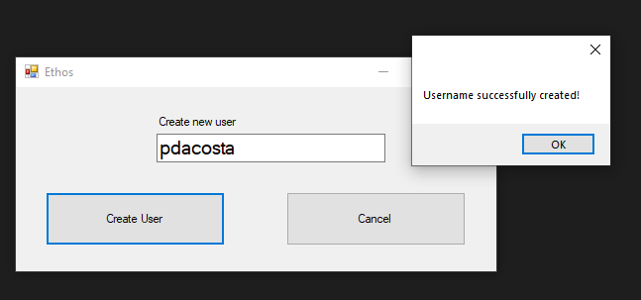
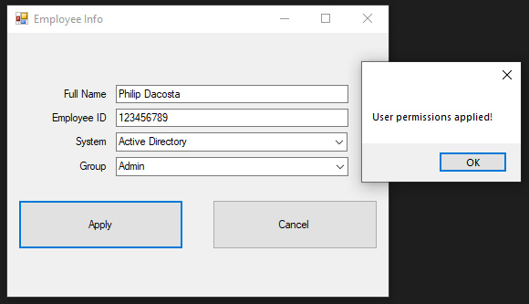
Use Case:
Add User
System and
Group
Notes:
Gustavo

Slide 15
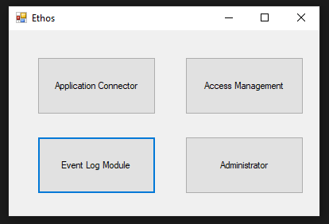
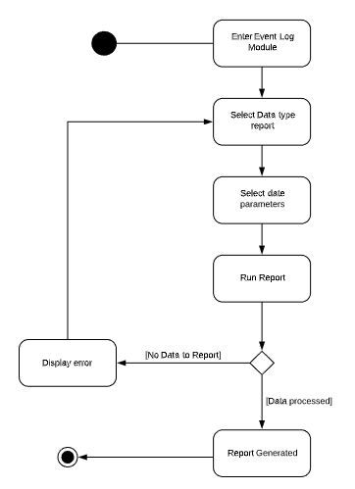
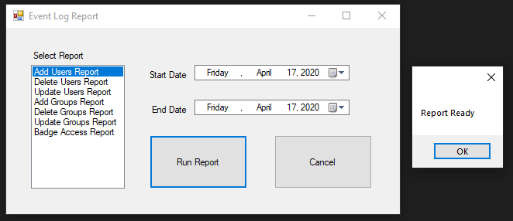
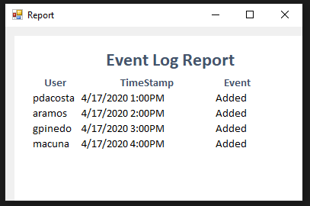
Use Case:
Generate
Event
Report
Notes:
Gustavo

Slide 16
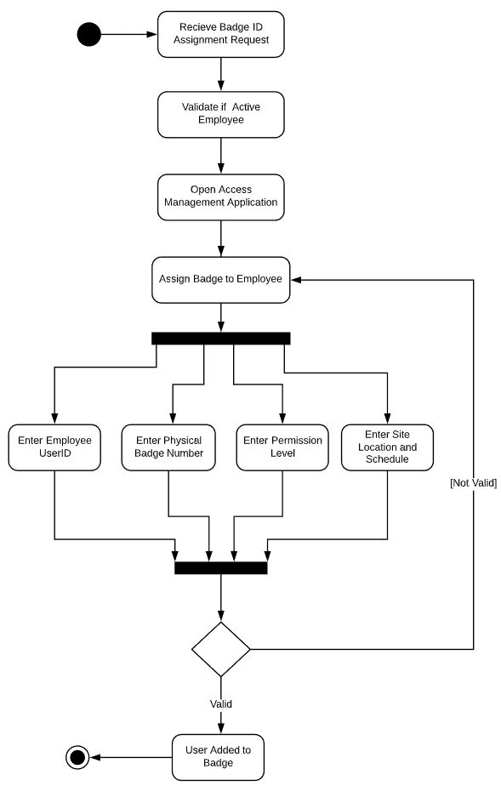
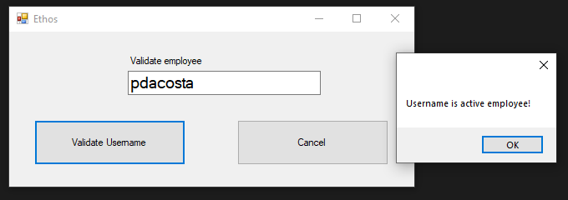
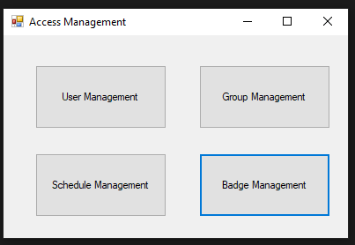
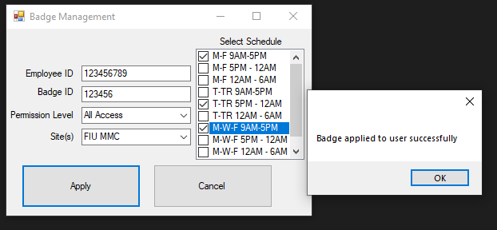
Use Case:
Assign Badge
to Employee
Notes:
Gustavo

Slide 17
Thank you

Slide 18
Q & A

